Slide 1
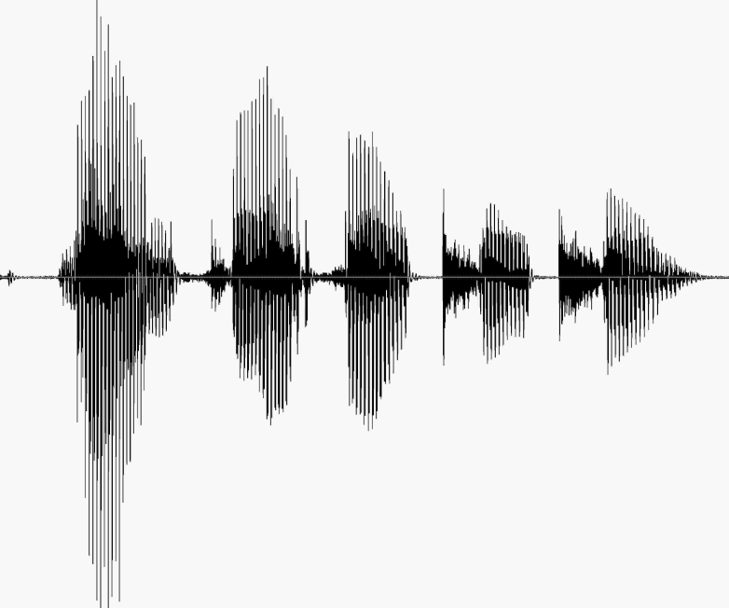
CS 224S / LINGUIST 285 Spoken Language Processing
Andrew Maas
Stanford University
Spring 2017
Lecture 5: GMM Acoustic Modeling and Feature Extraction
Original slides by Dan Jurafsky

Slide 2
Outline for Today
Acoustic Model
Acoustic likelihood for each state using Gaussians and Mixtures of Gaussians
Where a state is progressively:
CI Subphone (3ish per phone)
Context Dependent (CD) phone (=triphones)
State-tying of CD phone
MFCC feature extraction
Handling variation
MLLR adaptation
MAP adaptation (On your own)

Slide 3
Vector quantization: Discrete observations
feature value 2 for state j
feature value 1 for state j
Slide from John-Paul Hosum

Slide 4
VQ
We’ll define a
Codebook, which lists for each symbol
A prototype vector, or codeword
If we had 256 classes (‘8-bit VQ’),
A codebook with 256 prototype vectors
Given an incoming feature vector, we compare it to each of the 256 prototype vectors
We pick whichever one is closest (by some distance metric)
And replace the input vector by the index of this prototype vector

Slide 5
Vector Quantization
Create a training set of feature vectors
Cluster them into a small number of classes
Represent each class by a discrete symbol
For each class v_{k}, we can compute the probability that it is generated by a given HMM state using Baum-Welch

Slide 6
Vector quantization: Discrete observations
feature value 2 for state j
feature value 1 for state j
b_{j}(v_{k}) = number of vectors with codebook index k in state j
number of vectors in state j
14 1
= =
56 4
Slide from John-Paul Hosum

Slide 7
Directly Modeling Continuous Observations
Gaussians
Univariate Gaussians
Baum-Welch for univariate Gaussians
Multivariate Gaussians
Baum-Welch for multivariate Gausians
Gaussian Mixture Models (GMMs)
Baum-Welch for GMMs

Slide 8
Better than VQ
VQ is insufficient for real ASR
Instead: Assume the possible values of the observation feature vector o_{t} are normally distributed.
Represent the observation likelihood function b_{j}(o_{t}) as a Gaussian with mean μ_{j} and variance σ_{j}²

Slide 9
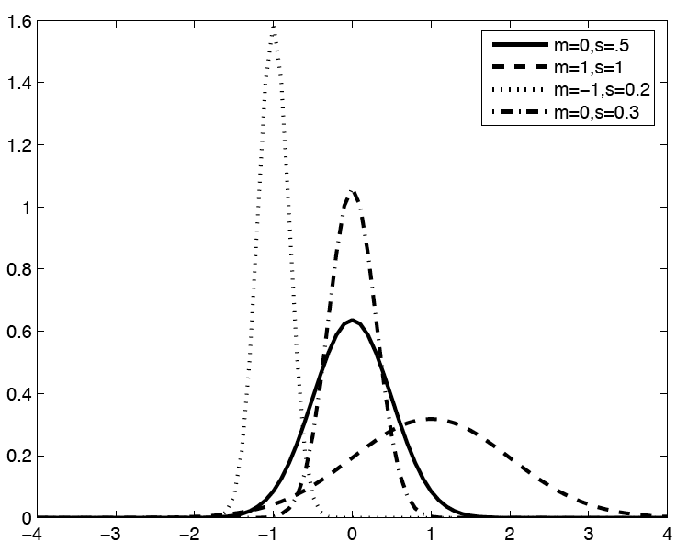
Gaussians are parameterized by mean and variance

Slide 10
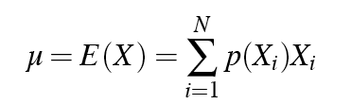
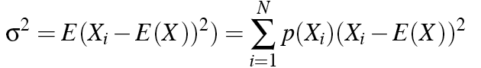
Reminder: means and variances
For a discrete random variable X
Mean is the expected value of X
Weighted sum over the values of X
Variance is the squared average deviation from mean

Slide 11
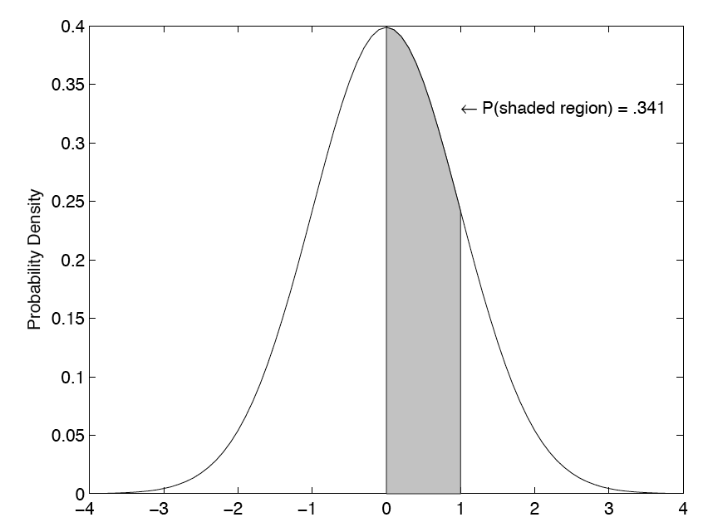
Gaussian as Probability Density Function
A Gaussian is a probability density function; probability is area under curve.
To make it a probability, constrain area under curve = 1

Slide 12
Gaussian PDFs
BUT…
We will be using “point estimates”; value of Gaussian at point.
Technically these are not probabilities, since a pdf gives a probability over a interval, needs to be multiplied by dx
As we will see later, this is ok since the same value is omitted from all Gaussians, so argmax is still correct.

Slide 13
Gaussians for Acoustic Modeling
P(o|q): A Gaussian parameterized by mean and variance:
Different means
P(o|q) is highest here at mean
P(o|q)
P(o|q) low here, far from mean
o

Slide 14
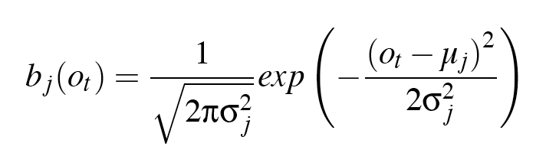
Using a (univariate) Gaussian as an acoustic likelihood estimator
Let’s suppose our observation was a single real-valued feature (instead of 39D vector)
Then if we had learned a Gaussian over the distribution of values of this feature
We could compute the likelihood of any given observation o_{t} as follows:

Slide 15
Training a Univariate Gaussian
A (single) Gaussian is characterized by a mean and a variance
Imagine that we had some training data in which each state was labeled
We could just compute the mean and variance from the data:

Slide 16
Training Univariate Gaussians
But we don’t know which observation was produced by which state!
What we want: to assign each observation vector o_{t} to every possible state i, prorated by the probability the the HMM was in state i at time t.
The probability of being in state i at time t is γ_{t}(i)!!

Slide 17
Multivariate Gaussians
Instead of a single mean μ and variance σ:
Vector of observations x modeled by vector of means μ and covariance matrix Σ

Slide 18
Multivariate Gaussians
Defining μ and Σ
So the i-jth element of Σ is:

Slide 19
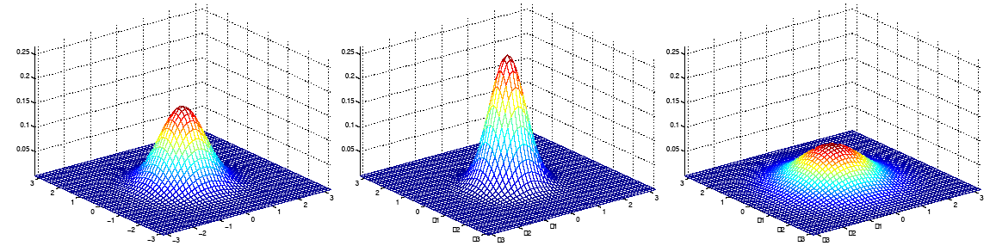
Gaussian Intuitions: Size of Σ
μ = [0 0] μ = [0 0] μ = [0 0]
Σ = I Σ = 0.6I Σ = 2I
As Σ becomes larger, Gaussian becomes more spread out; as Σ becomes smaller, Gaussian more compressed
From Andrew Ng’s lecture notes for CS229

Slide 20
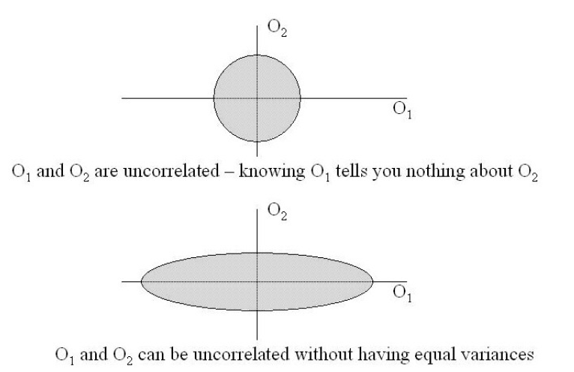
From Chen, Picheny et al lecture slides

Slide 21
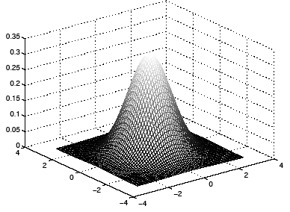
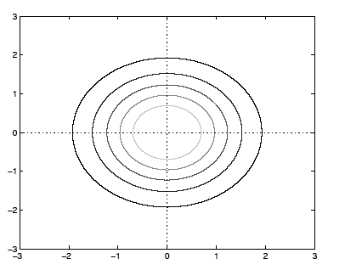
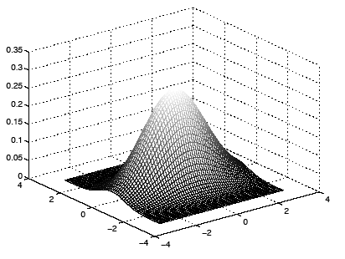
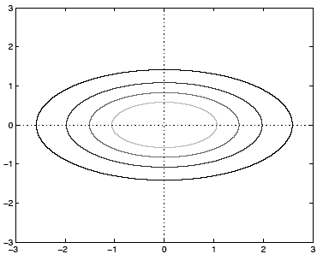
[1 0] [.6 0] [0 1] [ 0 2]
Different variances in different dimensions

Slide 22
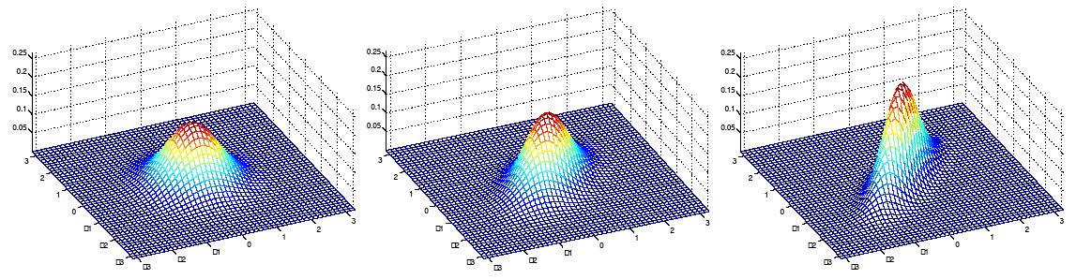
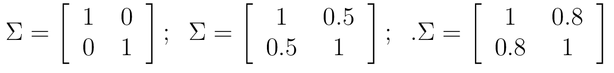
Gaussian Intuitions: Off-diagonal
As we increase the off-diagonal entries, more correlation between value of x and value of y
Text and figures from Andrew Ng’s lecture notes for CS229

Slide 23
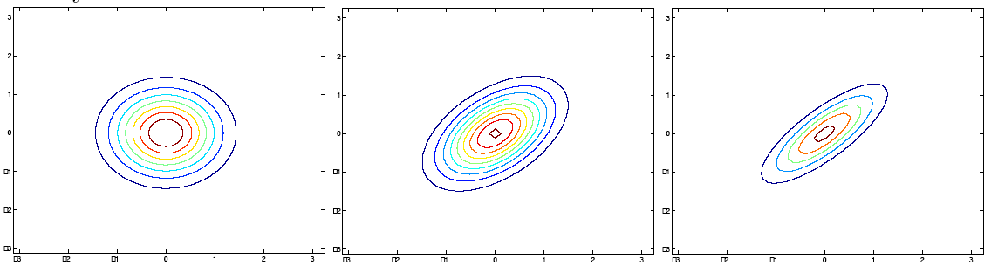
Gaussian Intuitions: off-diagonal
As we increase the off-diagonal entries, more correlation between value of x and value of y
Text and figures from Andrew Ng’s lecture notes for CS229

Slide 24
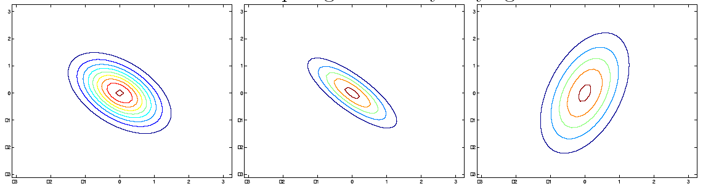

Gaussian Intuitions: off-diagonal and diagonal
Decreasing non-diagonal entries (#1-2)
Increasing variance of one dimension in diagonal (#3)
Text and figures from Andrew Ng’s lecture notes for CS229

Slide 25
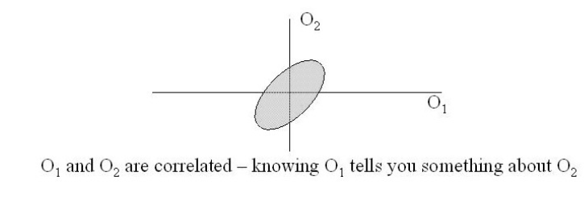
In two dimensions
From Chen, Picheny et al lecture slides

Slide 26
But: assume diagonal covariance
I.e., assume that the features in the feature vector are uncorrelated
This isn’t true for FFT features, but is true for MFCC features, as we will see later.
Computation and storage much cheaper if diagonal covariance.
I.e. only diagonal entries are non-zero
Diagonal contains the variance of each dimension σ_{ii}²
So this means we consider the variance of each acoustic feature (dimension) separately

Slide 27
Diagonal covariance
Diagonal contains the variance of each dimension σ_{ii}²
So this means we consider the variance of each acoustic feature (dimension) separately

Slide 28
Baum-Welch re-estimation equations for multivariate Gaussians
Natural extension of univariate case, where now μ_{i} is mean vector for state i:

Slide 29
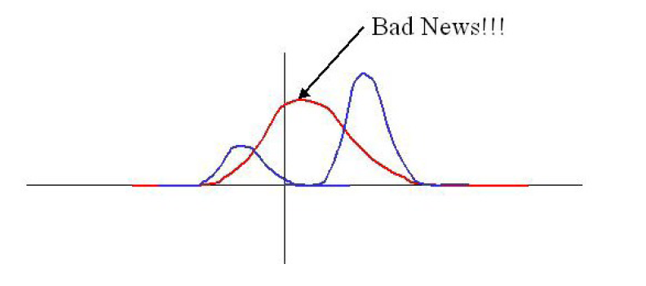
But we’re not there yet
Single Gaussian may do a bad job of modeling distribution in any dimension:
Solution: Mixtures of Gaussians
Figure from Chen, Picheney et al slides

Slide 30
Mixture of Gaussians to model a function

Slide 31
Mixtures of Gaussians
M mixtures of Gaussians:
For diagonal covariance:

Slide 32
GMMs
Summary: each state has a likelihood function parameterized by:
M Mixture weights
M Mean Vectors of dimensionality D
Either
M Covariance Matrices of DxD
Or more likely
M Diagonal Covariance Matrices of DxD
which is equivalent to
M Variance Vectors of dimensionality D

Slide 33
Training a GMM
Problem: how do we train a GMM if we don’t know what component is accounting for aspects of any particular observation?
Intuition: we use Baum-Welch to find it for us, just as we did for finding hidden states that accounted for the observation

Slide 34
Baum-Welch for Mixture Models
By analogy with γ earlier, let’s define the probability of being in state j at time t with the kth mixture component accounting for o_{t}:
Now,

Slide 35
How to train mixtures?
Choose M (often 16; or can tune M dependent on amount of training observations)
Then can do various splitting or clustering algorithms. One simple method for “splitting”:
Compute global mean μ and global variance
Split into two Gaussians, with means μ±ε (sometimes ε is 0.2σ)
Run Forward-Backward to retrain
Go to 1 until we have 16 mixtures

Slide 36
Embedded Training
Components of a speech recognizer:
Feature extraction: not statistical
Language model: word transition probabilities, trained on some other corpus
Acoustic model:
Pronunciation lexicon: the HMM structure for each word, built by hand
Observation likelihoods b_{j}(o_{t})
Transition probabilities a_{ij}

Slide 37
Embedded training of acoustic model
If we had hand-segmented and hand-labeled training data
With word and phone boundaries
We could just compute
B: means and variances of all our triphone gaussians
A: transition probabilities
And we’d be done!
But we don’t have word and phone boundaries, nor phone labeling

Slide 38
Embedded training
Instead:
We’ll train each phone HMM embedded in an entire sentence
We’ll do word/phone segmentation and alignment automatically as part of training process

Slide 39
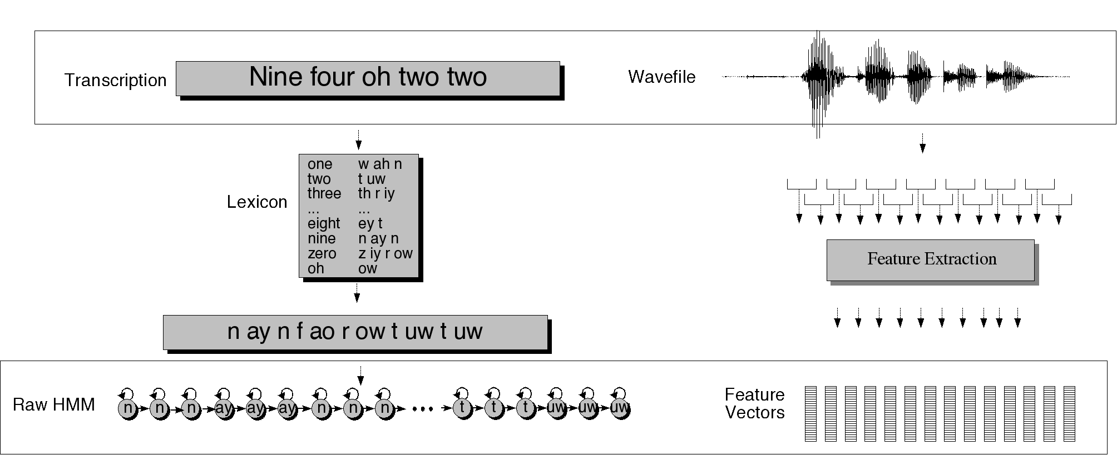
Embedded Training

Slide 40
Initialization: “Flat start”
Transition probabilities:
set to zero any that you want to be “structurally zero”
Set the rest to identical values
Likelihoods:
initialize μ and σ of each state to global mean and variance of all training data

Slide 41
Embedded Training
Given: phoneset, lexicon, transcribed wavefiles
Build a whole sentence HMM for each sentence
Initialize A probs to 0.5, or to zero
Initialize B probs to global mean and variance
Run multiple iterations of Baum Welch
During each iteration, we compute forward and backward probabilities
Use them to re-estimate A and B
Run Baum-Welch until convergence.

Slide 42
Viterbi training
Baum-Welch training says:
We need to know what state we were in, to accumulate counts of a given output symbol o_{t}
We’ll compute γ_{i}(t), the probability of being in state i at time t, by using forward-backward to sum over all possible paths that might have been in state i and output o_{t}.
Viterbi training says:
Instead of summing over all possible paths, just take the single most likely path
Use the Viterbi algorithm to compute this “Viterbi” path
Via “forced alignment”

Slide 43
Forced Alignment
Computing the “Viterbi path” over the training data is called “forced alignment”
Because we know which word string to assign to each observation sequence.
We just don’t know the state sequence.
So we use a_{ij} to constrain the path to go through the correct words
And otherwise do normal Viterbi
Result: state sequence!

Slide 44
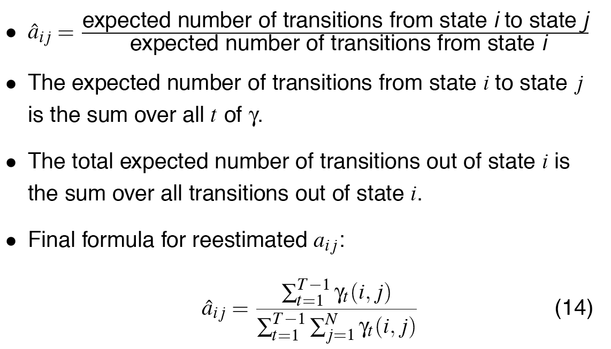
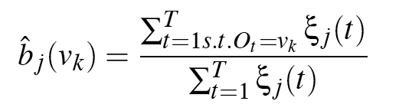
Viterbi training equations
Viterbi Baum-Welch
For all pairs of emitting states,
1 <= i, j <= N
Where n_{ij} is number of frames with transition from i to j in best path
And n_{j} is number of frames where state j is occupied

Slide 45
Viterbi Training
Much faster than Baum-Welch
But doesn’t work quite as well
But the tradeoff is often worth it.

Slide 46
Viterbi training (II)
Equations for non-mixture Gaussians
Viterbi training for mixture Gaussians is more complex, generally just assign each observation to 1 mixture

Slide 47
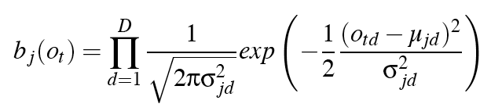
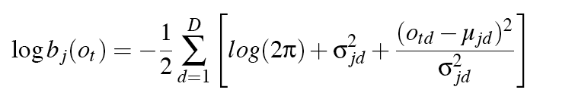
Log domain
In practice, do all computation in log domain
Avoids underflow
Instead of multiplying lots of very small probabilities, we add numbers that are not so small.
Single multivariate Gaussian (diagonal Σ) compute:
In log space:

Slide 48
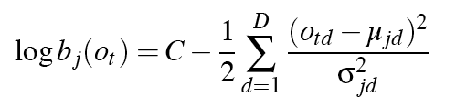
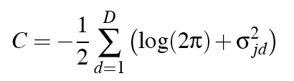
Log domain
Repeating:
With some rearrangement of terms
Where:
Note that this looks like a weighted Mahalanobis distance!!!
Also may justify why we these aren’t really probabilities (point estimates); these are really just distances.

Slide 49
Outline for Today
Acoustic Model
Acoustic likelihood for each state using Gaussians and Mixtures of Gaussians
Where a state is progressively:
CI Subphone (3ish per phone)
Context Dependent (CD) phone (=triphones)
State-tying of CD phone
MFCC feature extraction
Handling variation
MLLR adaptation
MAP adaptation (On your own)

Slide 50
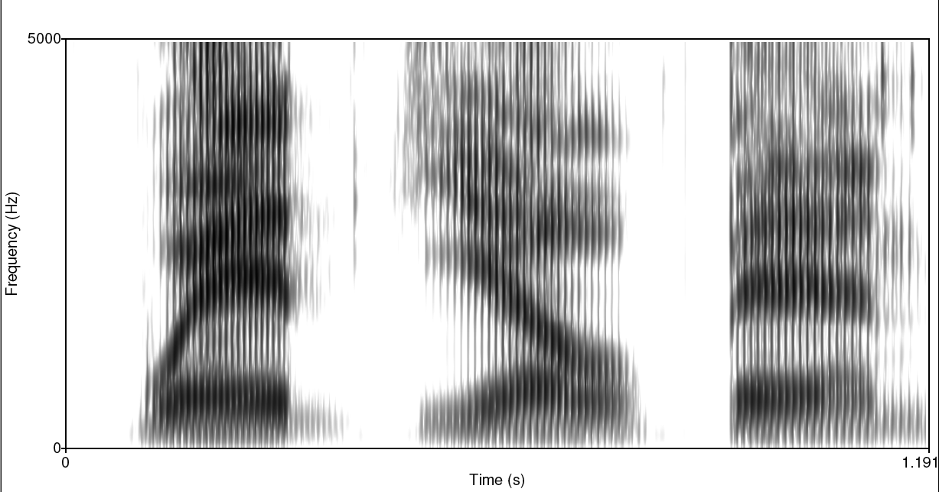
Phonetic context: different “eh”s
w eh d y eh l b eh n

Slide 51
Modeling phonetic context
The strongest factor affecting phonetic variability is the neighboring phone
How to model that in HMMs?
Idea: have phone models which are specific to context.
Instead of Context-Independent (CI) phones
We’ll have Context-Dependent (CD) phones

Slide 52
CD phones: triphones
Triphones
Each triphone captures facts about preceding and following phone
Monophone:
p, t, k
Triphone:
iy-p+aa
a-b+c means “phone b, preceding by phone a, followed by phone c”

Slide 53
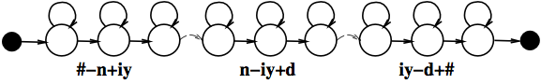
“Need” with triphone models

Slide 54
Word-Boundary Modeling
Word-Internal Context-Dependent Models
‘OUR LIST’:
SIL AA+R AA-R L+IH L-IH+S IH-S+T S-T
Cross-Word Context-Dependent Models
‘OUR LIST’:
SIL-AA+R AA-R+L R-L+IH L-IH+S IH-S+T S-T+SIL
Dealing with cross-words makes decoding harder!

Slide 55
Implications of Cross-Word Triphones
Possible triphones: 50x50x50=125,000
How many triphone types actually occur?
20K word WSJ Task, numbers from Young et al
Cross-word models: need 55,000 triphones
But in training data only 18,500 triphones occur!
Need to generalize models

Slide 56
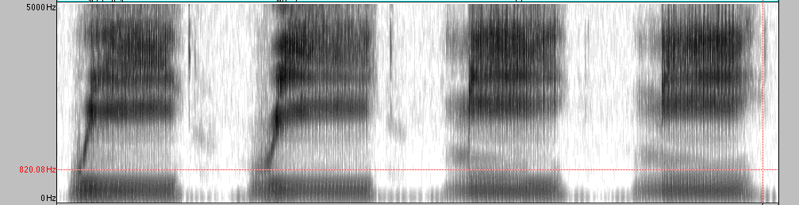
Modeling phonetic context: some contexts look similar
w iy r iy m iy n iy

Slide 57
Solution: State Tying
Young, Odell, Woodland 1994
Decision-Tree based clustering of triphone states
States which are clustered together will share their Gaussians
We call this “state tying”, since these states are “tied together” to the same Gaussian.

Slide 58
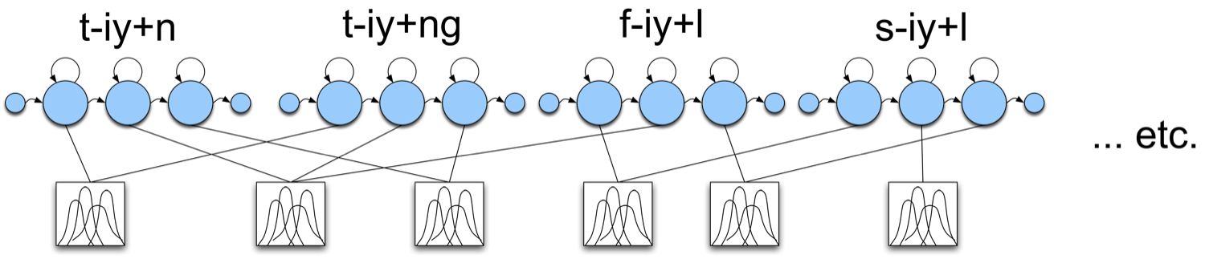
Young et al state tying

Slide 59
State tying/clustering
How do we decide which triphones to cluster together?
Use phonetic features (or ‘broad phonetic classes’)
Stop
Nasal
Fricative
Sibilant
Vowel
Lateral

Slide 60
Decision tree for clustering triphones for tying

Slide 61
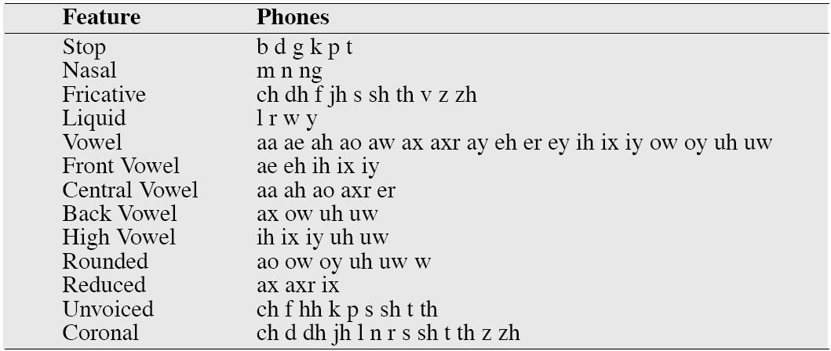
Decision tree for clustering triphones for tying

Slide 62
State Tying: Young, Odell, Woodland 1994

Slide 63
Summary: Acoustic Modeling for LVCSR
Increasingly sophisticated models
For each state:
Gaussians
Multivariate Gaussians
Mixtures of Multivariate Gaussians
Where a state is progressively:
CI Phone
CI Subphone (3ish per phone)
CD phone (=triphones)
State-tying of CD phone
Neural network acoustic models after all of the above
Viterbi training

Slide 64
Summary: ASR Architecture
Five easy pieces: ASR Noisy Channel architecture
Feature Extraction:
39 “MFCC” features
Acoustic Model:
Gaussians for computing p(o|q)
Lexicon/Pronunciation Model
HMM: what phones can follow each other
Language Model
N-grams for computing p(wi|wi-1)
Decoder
Viterbi algorithm: dynamic programming for combining all these to get word sequence from speech!

Slide 65
Outline for Today
Acoustic Model
Acoustic likelihood for each state using Gaussians and Mixtures of Gaussians
Where a state is progressively:
CI Subphone (3ish per phone)
Context Dependent (CD) phone (=triphones)
State-tying of CD phone
MFCC feature extraction
Handling variation
MLLR adaptation
MAP adaptation (On your own)

Slide 66
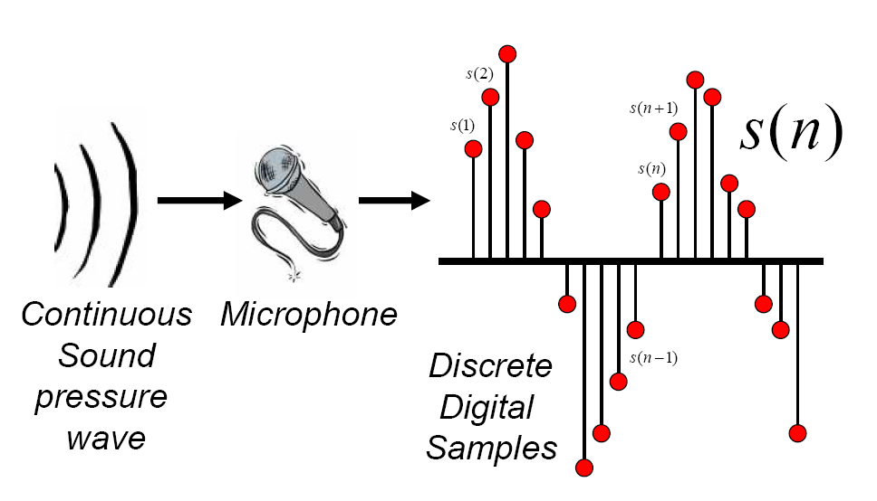
Discrete Representation of Signal
Represent continuous signal into discrete form.
Image from Bryan Pellom

Slide 67
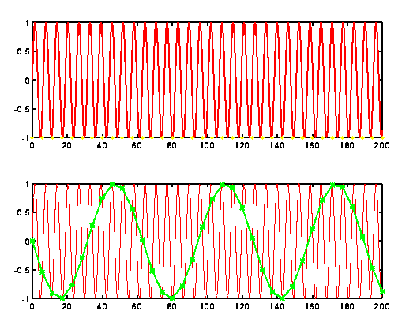
Sampling
Original signal in red:
If measure at green dots, will see a lower frequency wave and miss the correct higher frequency one!

Slide 68
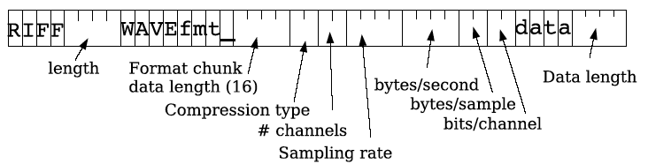
WAV format
Many formats, trade-offs in compression, quality
Nice sound manipulation tool: Sox
http://sox.sourceforge.net/
convert speech formats

Slide 69
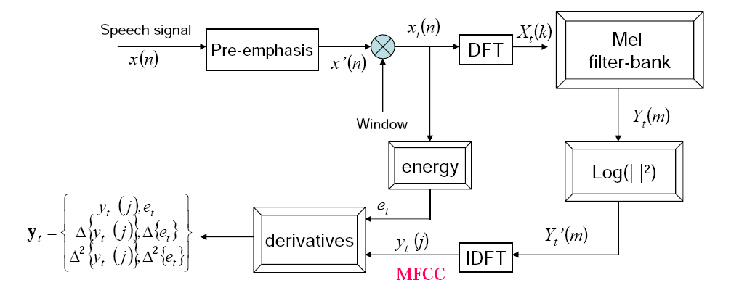
MFCC
Mel-Frequency Cepstral Coefficient (MFCC)
Most widely used spectral representation in ASR

Slide 70
MFCC
Mel-Frequency Cepstral Coefficient (MFCC)
Most widely used spectral representation in ASR

Slide 71
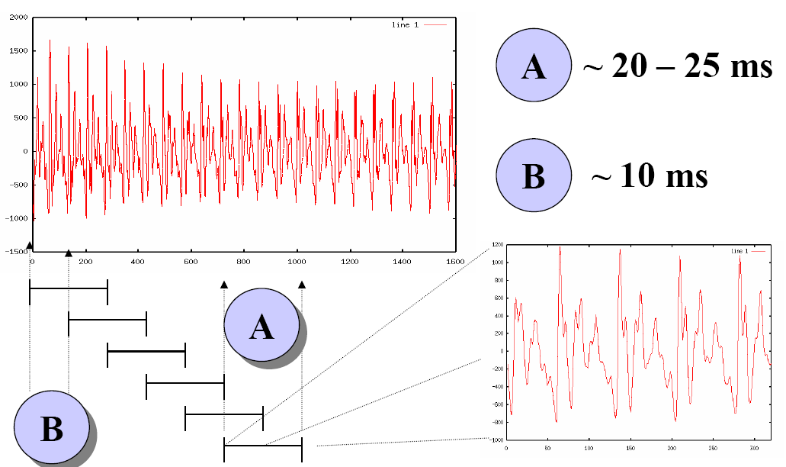
Windowing
Image from Bryan Pellom

Slide 72
MFCC

Slide 73
Discrete Fourier Transform computing a spectrum
A 25 ms Hamming-windowed signal from [iy]
And its spectrum as computed by DFT (plus other smoothing)

Slide 74
MFCC

Slide 75
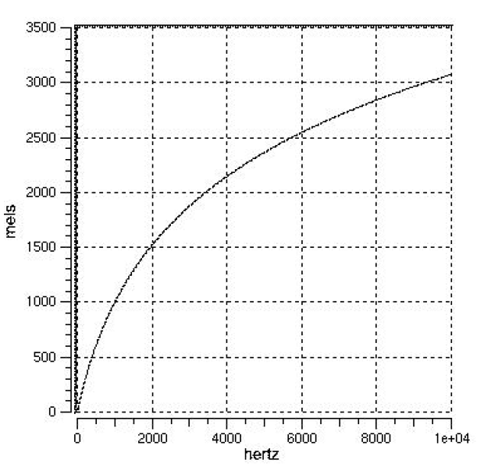
Mel-scale
Human hearing is not equally sensitive to all frequency bands
Less sensitive at higher frequencies, roughly > 1000 Hz
I.e. human perception of frequency is non-linear:

Slide 76
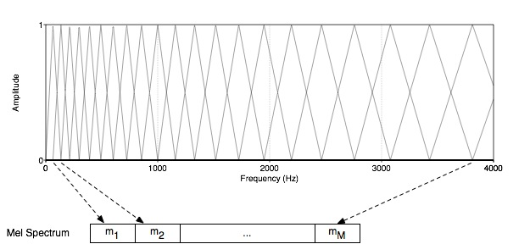
Mel Filter Bank Processing
Mel Filter bank
Roughly uniformly spaced before 1 kHz
logarithmic scale after 1 kHz

Slide 77
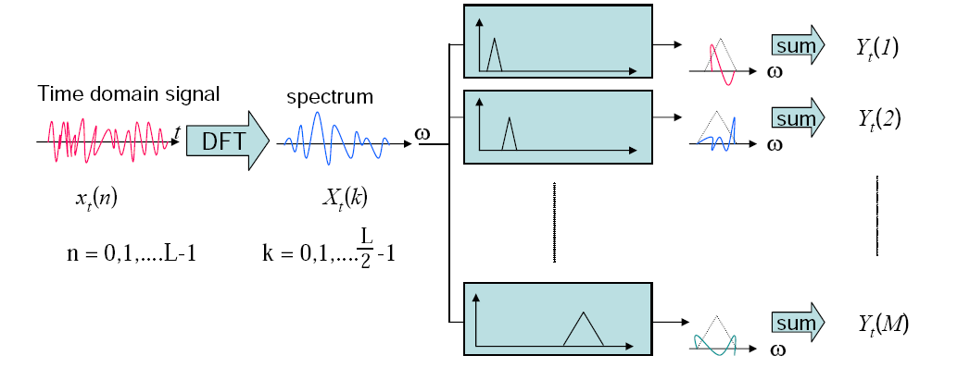
Mel-filter Bank Processing
Apply the bank of Mel-scaled filters to the spectrum
Each filter output is the sum of its filtered spectral components

Slide 78
MFCC

Slide 79
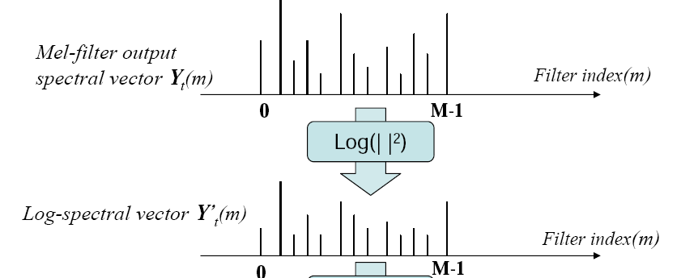
Log energy computation
Compute the logarithm of the square magnitude of the output of Mel-filter bank

Slide 80
MFCC

Slide 81
The Cepstrum
One way to think about this
Separating the source and filter
Speech waveform is created by
A glottal source waveform
Passes through a vocal tract which because of its shape has a particular filtering characteristic
Remember articulatory facts from lecture 2:
The vocal cord vibrations create harmonics
The mouth is an amplifier
Depending on shape of oral cavity, some harmonics are amplified more than others

Slide 82
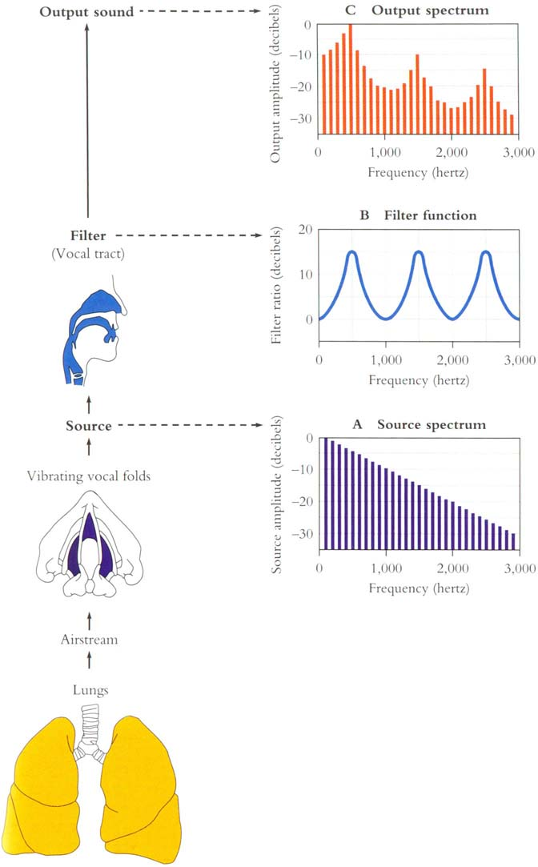
George Miller figure

Slide 83
We care about the filter not the source
Most characteristics of the source
F0
Details of glottal pulse
Don’t matter for phone detection
What we care about is the filter
The exact position of the articulators in the oral tract
So we want a way to separate these
And use only the filter function

Slide 84
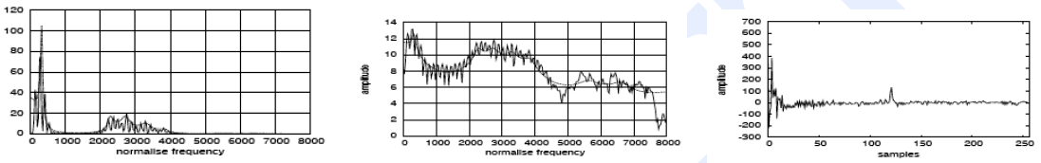
The Cepstrum
The spectrum of the log of the spectrum
Spectrum
Log spectrum
Spectrum of log spectrum

Slide 85
Another advantage of the Cepstrum
DCT produces highly uncorrelated features
If we use only the diagonal covariance matrix for our Gaussian mixture models, we can only handle uncorrelated features.
In general we’ll just use the first 12 cepstral coefficients (we don’t want the later ones which have e.g. the F0 spike)

Slide 86
MFCC

Slide 87
“Delta” features
Speech signal is not constant
slope of formants,
change from stop burst to release
So in addition to the cepstral features
Need to model changes in the cepstral features over time.
“delta features”
“double delta” (acceleration) features

Slide 88
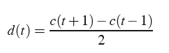
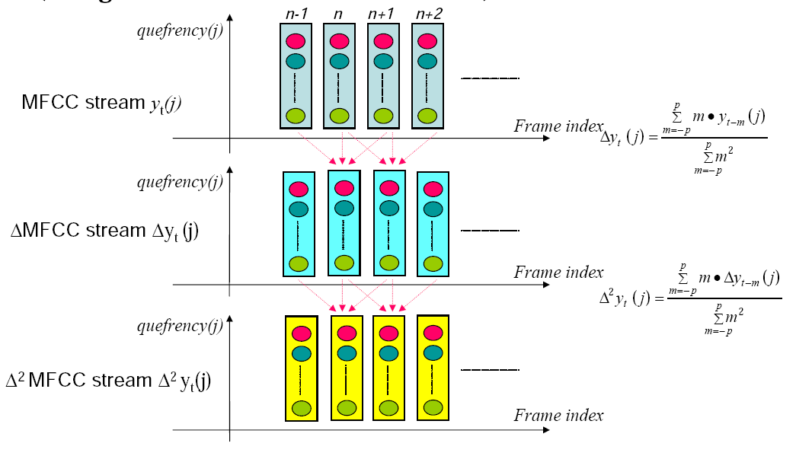
Delta and double-delta
Derivative: in order to obtain temporal information

Slide 89
Typical MFCC features
Window size: 25ms
Window shift: 10ms
Pre-emphasis coefficient: 0.97
MFCC:
12 MFCC (mel frequency cepstral coefficients)
1 energy feature
12 delta MFCC features
12 double-delta MFCC features
1 delta energy feature
1 double-delta energy feature
Total 39-dimensional features

Slide 90
Why is MFCC so popular?
Efficient to compute
Incorporates a perceptual Mel frequency scale
Separates the source and filter
IDFT(DCT) decorrelates the features
Necessary for diagonal assumption in HMM modeling
There are alternatives like PLP
Choice matters less for neural network acoustic models (in future lectures)

Slide 91
Outline for Today
Acoustic Model
Acoustic likelihood for each state using Gaussians and Mixtures of Gaussians
Where a state is progressively:
CI Subphone (3ish per phone)
CD phone (=triphones)
State-tying of CD phone
MFCC feature extraction
Handling variation
MLLR adaptation
MAP adaptation (On your own)

Slide 92
Acoustic Model Adaptation
Shift the means and variances of Gaussians to better match the input feature distribution
Maximum Likelihood Linear Regression (MLLR)
Maximum A Posteriori (MAP) Adaptation
For both speaker adaptation and environment adaptation
Widely used!

Slide 93
Maximum Likelihood Linear Regression (MLLR)
Leggetter, C.J. and P. Woodland. 1995. Maximum likelihood linear regression for speaker adaptation of continuous density hidden Markov models. Computer Speech and Language 9:2, 171-185.
Given:
a trained AM
a small “adaptation” dataset from a new speaker
Learn new values for the Gaussian mean vectors
Not by just training on the new data (too small)
But by learning a linear transform which moves the means.

Slide 94
Maximum Likelihood Linear Regression (MLLR)
Estimates a linear transform matrix (W) and bias vector (ω) to transform HMM model means:
Transform estimated to maximize the likelihood of the adaptation data
Slide from Bryan Pellom

Slide 95
MLLR
New equation for output likelihood

Slide 96
MLLR
Q: Why is estimating a linear transform from adaptation data different than just training on the data?
A: Even from a very small amount of data we can learn 1 single transform for all triphones! So small number of parameters.
A2: If we have enough data, we could learn more transforms (but still less than the number of triphones). One per phone (~50) is often done.

Slide 97
MLLR: Learning
Given
a small labeled adaptation set (a couple sentences)
a trained AM
Do forward-backward alignment on adaptation set to compute state occupation probabilities γ_{j}(t).
W can now be computed by solving a system of simultaneous equations involving γ_{j}(t)

Slide 98
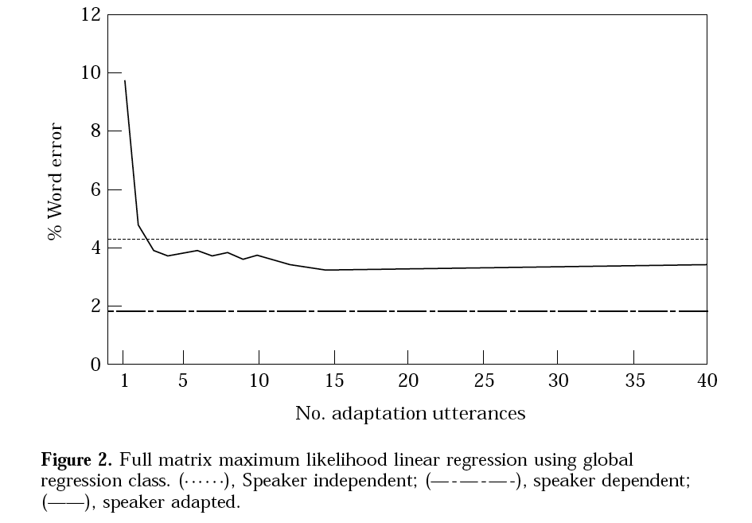
MLLR performance on baby task (RM) (Leggetter and Woodland 1995)
Only 3 sentences!
11 seconds of speech!

Slide 99
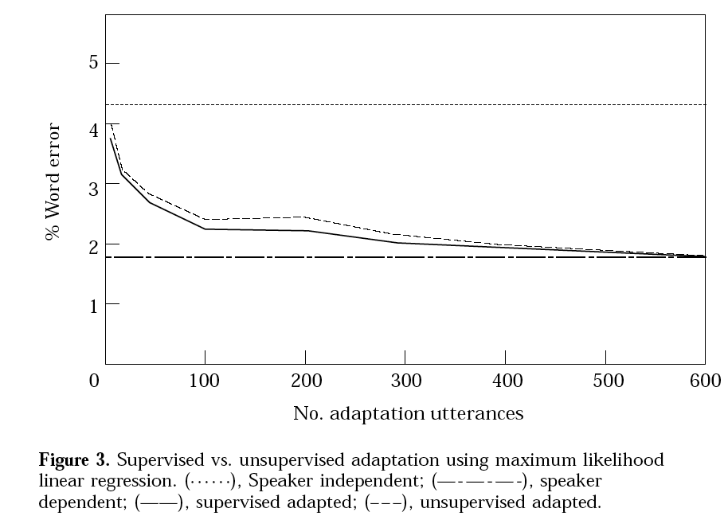
MLLR doesn’t need supervised adaptation set!

Slide 100
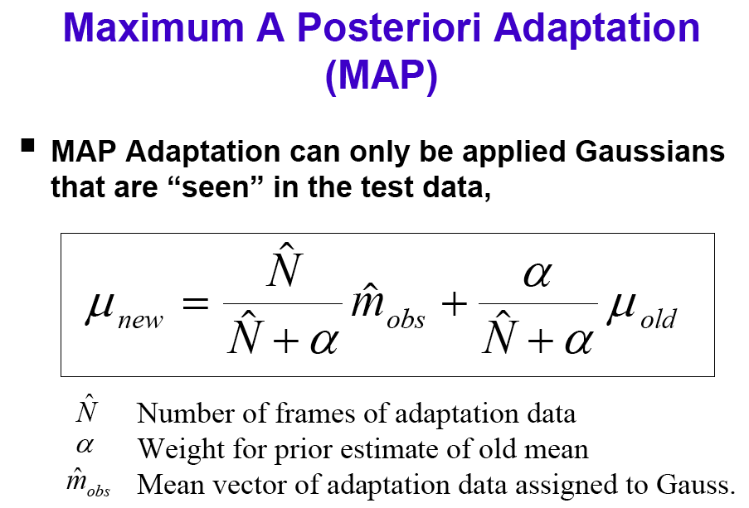
Slide from Bryan Pellom

Slide 101
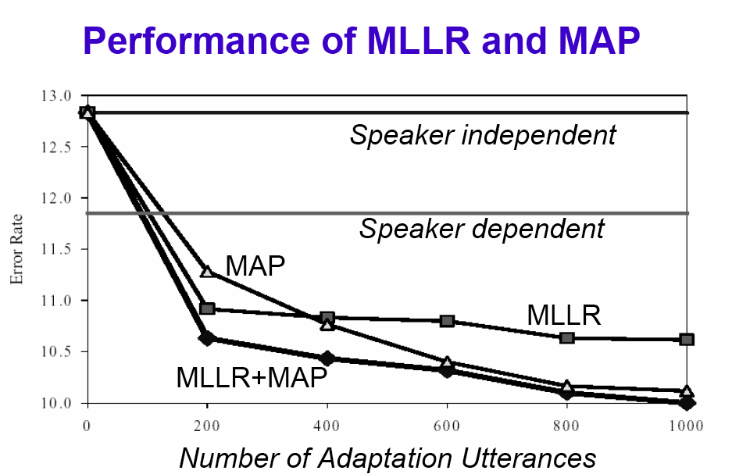
Slide from Bryan Pellom after Huang et al

Slide 102
Summary
MLLR: works on small amounts of adaptation data
MAP: Maximum A Posterior Adaptation
Works well on large adaptation sets
Acoustic adaptation techniques are quite successful at dealing with speaker variability
If we can get 10 seconds with the speaker.

